Slide 1



My Christmas
Jesús Digón Abia
2ºDAW

Slide 2

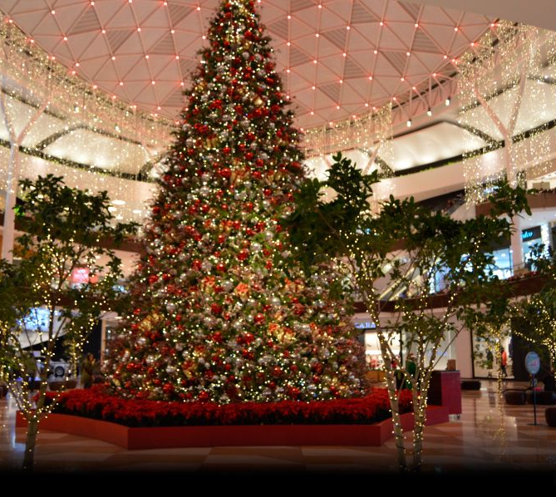

My experience in the shopping centers

Slide 3
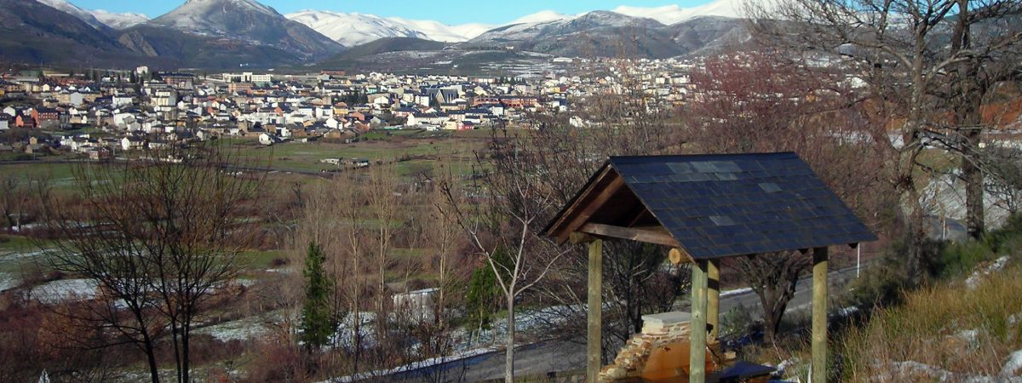
Visiting my father

Slide 4
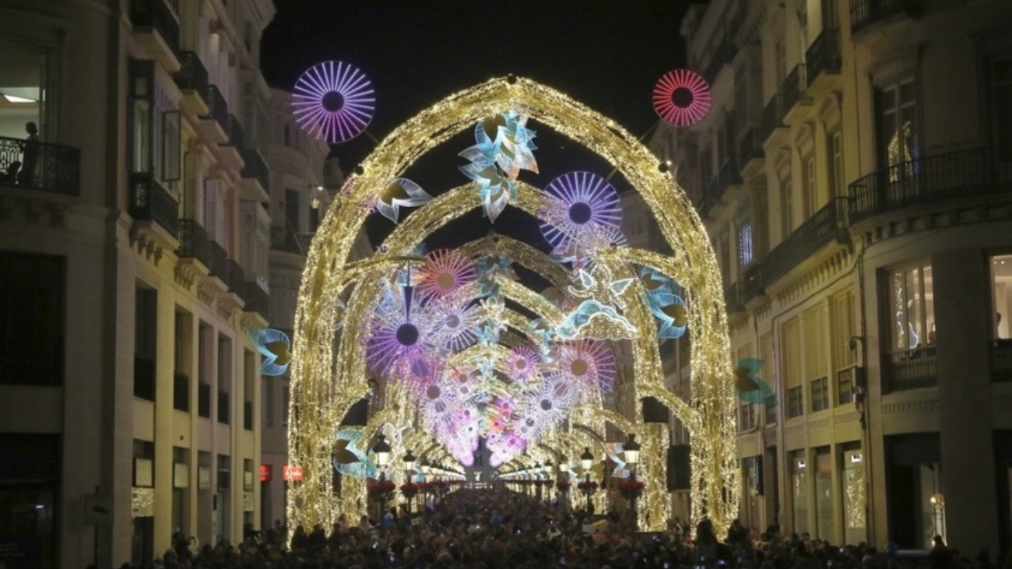
Málaga´s Christmas lights

Slide 5
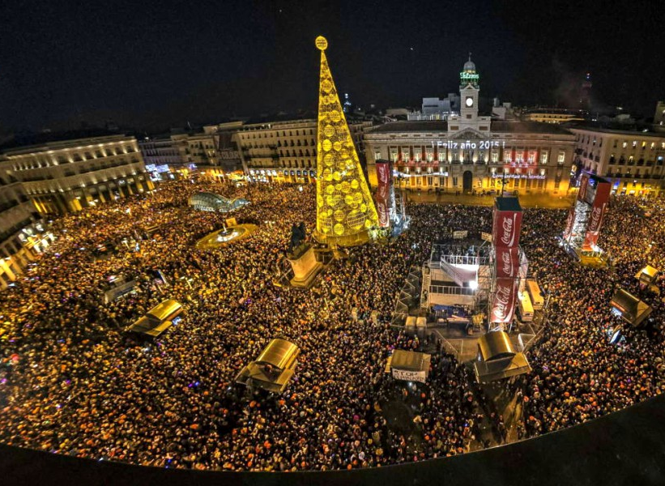
Christmas and New Year´s Eve

Slide 6

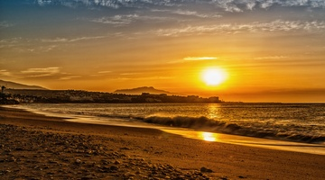
Málaga

Slide 7
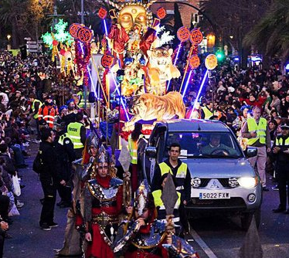
Cavalcade of the Three Kings

